Slide 1
ChangeDAR: Online Localized Change Detection for Sensors in a Graph
Bryan Hooi, Leman Akoglu, Dhivya Eswaran, Amritanshu Pandey,
Marko Jereminov, Larry Pileggi, Christos Faloutsos
Carnegie Mellon University

Slide 2
Introduction
Problem
Method
Experiments
Conclusion

Slide 3

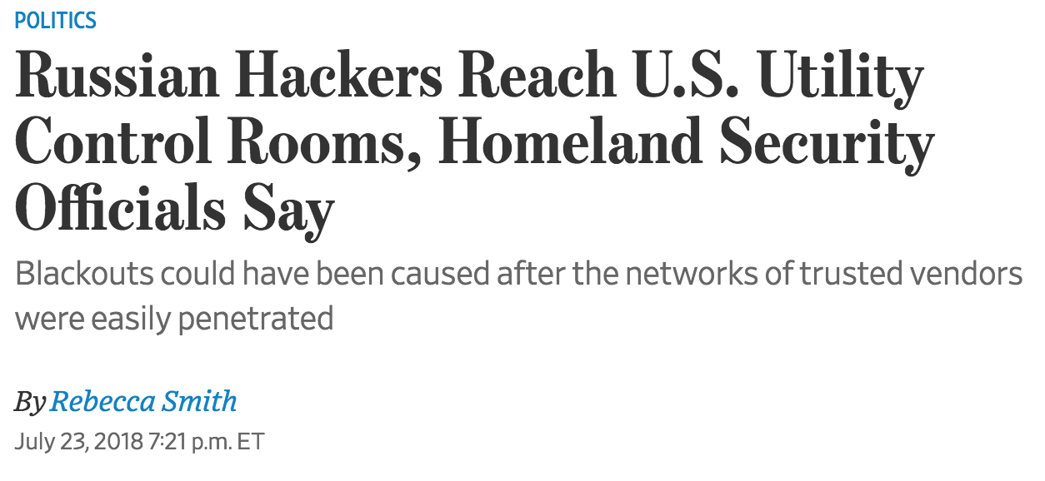
Introduction
Problem
Method
Experiments
Conclusion

Slide 4
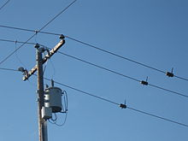
Electrical Grid Sensors
Introduction
Problem
Method
Experiments
Conclusion
T3.1: Detecting Anomalous Dynamic Subgraphs

Slide 5
Roadmap
Problem
Algorithm
Scoring
Detection
Experiments
Introduction
Problem
Method
Experiments
Conclusion
T3.1: Detecting Anomalous Dynamic Subgraphs

Slide 6
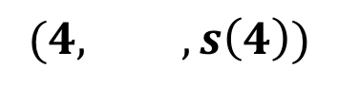
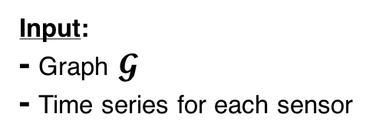
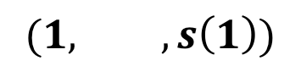
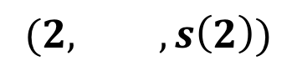
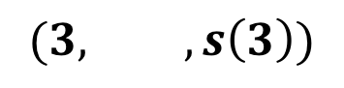

Problem 1: Change Scoring
Input:
- Graph $𝓖$
- Time series for each sensor
Time
tick
Best subgraph found at time 1
Score of best subgraph at time 1
$$(1, ,s\left(1\right))$$
Edge sensor
$$(2, ,s\left(2\right))$$
Change
Scoring
(Problem 1)
$$(3, ,s\left(3\right))$$
Missing sensors
$$(4, ,s\left(4\right))$$
Node sensor
$$…$$
Introduction
Problem
Method
Experiments
Conclusion
T3.1: Detecting Anomalous Dynamic Subgraphs

Slide 7
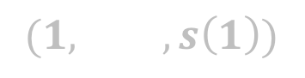
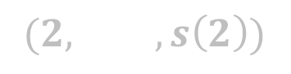
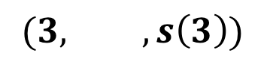

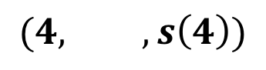
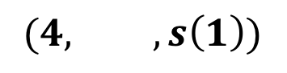
Problem 2: Change Detection
Input:
- Graph $𝓖$
- Time series for each sensor
Time
tick
Best subgraph found at time 1
Score of best subgraph at time 1
$$(1, ,s\left(1\right))$$
$$(1, ,s\left(1\right))$$
Edge sensor
$$(2, ,s\left(2\right))$$
$$(2, ,s\left(2\right))$$
Change
Scoring
(Problem 1)
Change
Detection
(Problem 2)
$$(3, ,s\left(3\right))$$
$$(3, ,s\left(3\right))$$
Missing sensors
$$(4, ,s\left(4\right))$$
$$(4, ,s\left(1\right))$$
Node sensor
$$…$$
$$…$$
Introduction
Problem
Method
Experiments
Conclusion
T3.1: Detecting Anomalous Dynamic Subgraphs
T3.1: Detecting Anomalous Dynamic Subgraphs

Slide 8
Roadmap
Problem
Algorithm
Scoring
Detection
Experiments
Introduction
Problem
Method
Experiments
Conclusion
T3.1: Detecting Anomalous Dynamic Subgraphs

Slide 9
Prize-Collecting Steiner Tree
Background
Cost
$10
Revenue
$20
$30
$15
$10
$20
$10
Which roads should we build?
$15
$10
$20
Introduction
Problem
Method
Experiments
Conclusion
T3.1: Detecting Anomalous Dynamic Subgraphs
T3.1: Detecting Anomalous Dynamic Subgraphs

Slide 10
Prize-Collecting Steiner Tree
Background
Cost
$10
Revenue
$20
$30
$15
$10
Net Profit
= $20 + $20 + $20 + $20
- $10 - $10 - $10 = $50
$20
$10
$15
$10
$20
Introduction
Problem
Method
Experiments
Conclusion
T3.1: Detecting Anomalous Dynamic Subgraphs
T3.1: Detecting Anomalous Dynamic Subgraphs

Slide 11
Encoding a Random Outcome
Background
The number of bits we need to encode an outcome is the negative log likelihood of the outcome
Examples
Coin flip: bits needed = -log₂(1/2) = 1
8 sided die: bits need = -log₂(1/8) = 3
Introduction
Problem
Method
Experiments
Conclusion
T3.1: Detecting Anomalous Dynamic Subgraphs
T3.1: Detecting Anomalous Dynamic Subgraphs

Slide 12
Encoding Univariate Time Series
Background
Data (Y)
Fitted Model (M)
Time
Minimum Description Length (≈ “Ockham’s Razor”) minimize Cost(Y) + Cost(Y | M)
Model cost
Data cost given model
Introduction
Problem
Method
Experiments
Conclusion
T3.1: Detecting Anomalous Dynamic Subgraphs
T3.1: Detecting Anomalous Dynamic Subgraphs

Slide 13
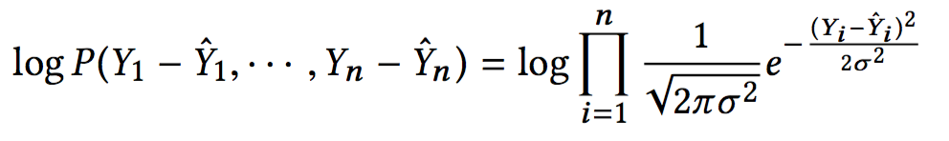
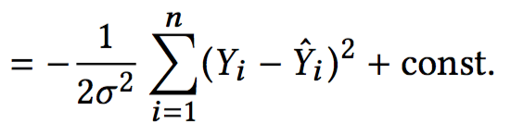
Encoding Univariate Time Series
Background
Data (Y)
Fitted Model (M)
Time
Model Cost: (No. of parameters) x (Cost per parameter)
Data Cost: negative log-likelihood of Y under Gaussian errors
= 1
= 32 bits
Residuals
Gaussian likelihood
Squared error
Introduction
Problem
Method
Experiments
Conclusion
T3.1: Detecting Anomalous Dynamic Subgraphs
T3.1: Detecting Anomalous Dynamic Subgraphs

Slide 14
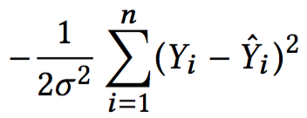
Univariate Change Detection
Background
Sensor
Value
Fitted Model (M)
Time
w
t
w
Model Cost = 32 bits
Data Cost = = 1000 bits
Introduction
Problem
Method
Experiments
Conclusion
T3.1: Detecting Anomalous Dynamic Subgraphs
T3.1: Detecting Anomalous Dynamic Subgraphs

Slide 15
Univariate Change Detection
Background
Sensor
Value
Fitted Model (M)
Time
w
t
w
Model Cost = 32 bits 72 bits
Data Cost = = 1000 bits 100 bits
Bits Saved:
Δ(t) = 860 bits
Introduction
Problem
Method
Experiments
Conclusion
T3.1: Detecting Anomalous Dynamic Subgraphs
T3.1: Detecting Anomalous Dynamic Subgraphs

Slide 16
Proposed (ChangeDAR): `Bitsave’ Scores
Δ_{v}(t): bits saved adding change point at node v at time t
Edge sensor
Δ_{e}(t): analogous, for edge e
Missing sensors
Node sensor
Introduction
Problem
Method
Experiments
Conclusion
T3.1: Detecting Anomalous Dynamic Subgraphs
T3.1: Detecting Anomalous Dynamic Subgraphs

Slide 17
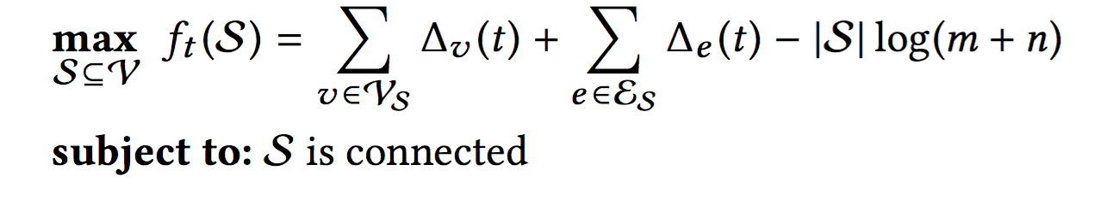
ChangeDAR: Anomalous Subgraphs
Details
We want a connected subgraph with high bitsave scores
Bits saved at
nodes and edges
Bits needed to encode S
Edge sensor
Missing sensors
Node sensor
Introduction
Problem
Method
Experiments
Conclusion
T3.1: Detecting Anomalous Dynamic Subgraphs
T3.1: Detecting Anomalous Dynamic Subgraphs

Slide 18
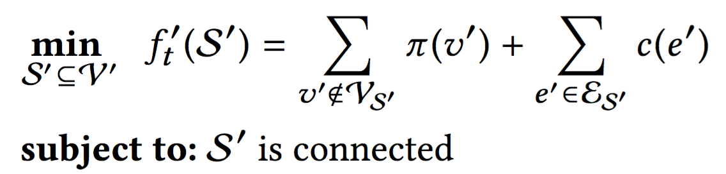
Optimization Algorithm
Details
Graph G
Graph G’
π₁=5
c₁=2
π₂=3
…
…
Edge sensor
Lemma: f_{t}(S) and f_{t}’(S’)
differ by a constant.
Missing sensors
Node sensor
Introduction
Problem
Method
Experiments
Conclusion
T3.1: Detecting Anomalous Dynamic Subgraphs
T3.1: Detecting Anomalous Dynamic Subgraphs

Slide 19
Optimization Algorithm
Details
Graph G
Graph G’
π₁=5
c₁=2
π₂=3
…
…
Edge sensor
Missing sensors
Node sensor
Optimize using Prize-Collecting
Steiner Tree Algorithm
Introduction
Problem
Method
Experiments
Conclusion
T3.1: Detecting Anomalous Dynamic Subgraphs
T3.1: Detecting Anomalous Dynamic Subgraphs

Slide 20
Optimization Algorithm
Details
Graph G’
Theorem 1: f’_{t}(S’) can be optimized in near-linear time with approximation factor 2
π₁=5
c₁=2
π₂=3
…
…
Introduction
Problem
Method
Experiments
Conclusion
T3.1: Detecting Anomalous Dynamic Subgraphs
T3.1: Detecting Anomalous Dynamic Subgraphs

Slide 21
Optimization Algorithm
Details
Graph G
Graph G’
Recover anomalous
subgraph
π₁=5
c₁=2
π₂=3
…
…
Edge sensor
Missing sensors
Node sensor
Introduction
Problem
Method
Experiments
Conclusion
T3.1: Detecting Anomalous Dynamic Subgraphs
T3.1: Detecting Anomalous Dynamic Subgraphs

Slide 22
Roadmap
Problem
Algorithm
Scoring
Detection
Experiments
Introduction
Problem
Method
Experiments
Conclusion
T3.1: Detecting Anomalous Dynamic Subgraphs

Slide 23
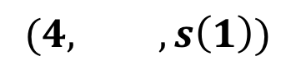
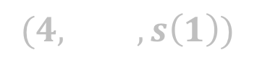
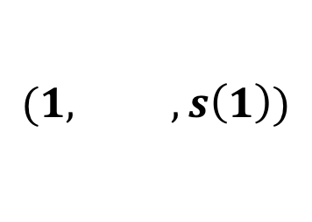
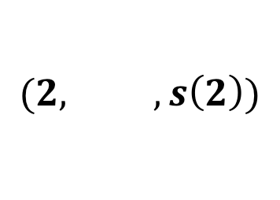
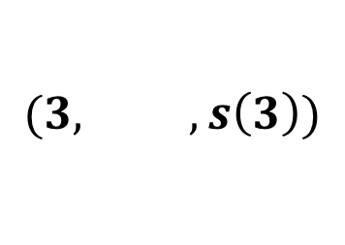
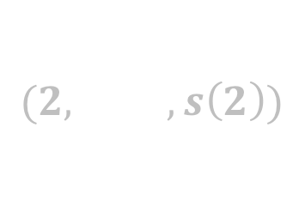
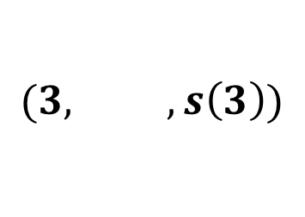
Problem 2: Change Detection
Input:
- Graph $𝓖$
- Time series for each sensor
Time
tick
Best subgraph found at time 1
Score of best subgraph at time 1
$$(1, ,s\left(1\right))$$
$$(1, ,s\left(1\right))$$
Edge sensor
$$(2, ,s\left(2\right))$$
$$(2, ,s\left(2\right))$$
Change
Scoring
(Problem 1)
Change
Detection
(Problem 2)
$$(3, ,s\left(3\right))$$
$$(3, ,s\left(3\right))$$
Missing sensors
$$(4, ,s\left(1\right))$$
$$(4, ,s\left(1\right))$$
Node sensor
$$…$$
$$…$$
Introduction
Problem
Method
Experiments
Conclusion
T3.1: Detecting Anomalous Dynamic Subgraphs
T3.1: Detecting Anomalous Dynamic Subgraphs

Slide 24
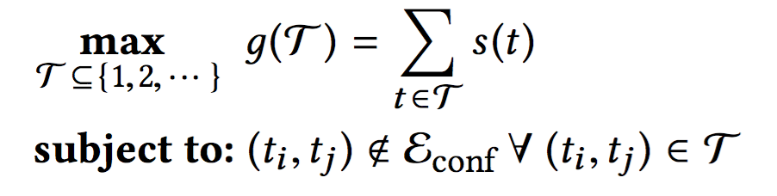
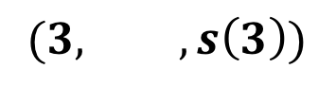
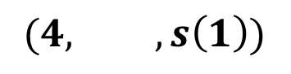
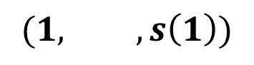
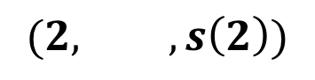
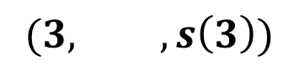
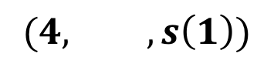


Change Detection (Main Ideas)
Some changes conflict (e.g. the same change, 1 second later)
Conflicts
$$(1, ,s\left(1\right))$$
$$(1, ,s\left(1\right))$$
$$(2, ,s\left(2\right))$$
$$(2, ,s\left(2\right))$$
Change
Detection
(Problem 2)
$$(3, ,s\left(3\right))$$
$$(3, ,s\left(3\right))$$
$$(4, ,s\left(1\right))$$
$$(4, ,s\left(1\right))$$
Goal: search for optimal subset of changes with highest bitsave score
Introduction
Problem
Method
Experiments
Conclusion
T3.1: Detecting Anomalous Dynamic Subgraphs
T3.1: Detecting Anomalous Dynamic Subgraphs

Slide 25
Change Detection (Main Ideas)
Details
Goal: search for optimal subset of changes with highest bitsave score
Bitsave score
Non-conflicting change set
Approach:
Constrained online variant of Maximum Independent Set
We use a hybrid greedy-randomized approach, with approx. guarantees
Introduction
Problem
Method
Experiments
Conclusion
T3.1: Detecting Anomalous Dynamic Subgraphs
T3.1: Detecting Anomalous Dynamic Subgraphs

Slide 26
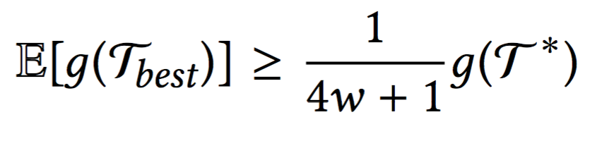
Theoretical Results
Details
Theorem 2: constant approximation factor in expectation:
Score of algorithm
Window
Optimal score
Introduction
Problem
Method
Experiments
Conclusion
T3.1: Detecting Anomalous Dynamic Subgraphs
T3.1: Detecting Anomalous Dynamic Subgraphs

Slide 27
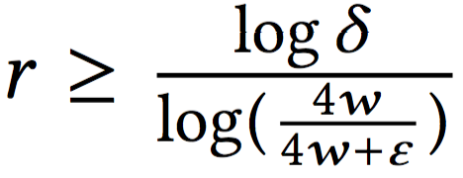
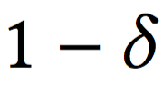
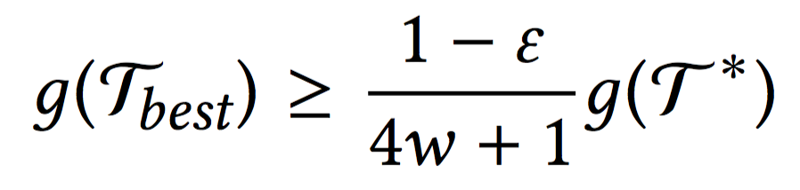
Theoretical Results
Details
Theorem 3: constant approximation factor with high probability:
if , then with probability at least :
Score of algorithm
Optimal score
Window
Introduction
Problem
Method
Experiments
Conclusion
T3.1: Detecting Anomalous Dynamic Subgraphs
T3.1: Detecting Anomalous Dynamic Subgraphs

Slide 28
Roadmap
Problem
Algorithm
Scoring
Detection
Experiments
Introduction
Problem
Method
Experiments
Conclusion
T3.1: Detecting Anomalous Dynamic Subgraphs

Slide 29
Experiment 1: Power Grid Failures
Introduction
Problem
Method
Experiments
Conclusion
T3.1: Detecting Anomalous Dynamic Subgraphs
T3.1: Detecting Anomalous Dynamic Subgraphs

Slide 30
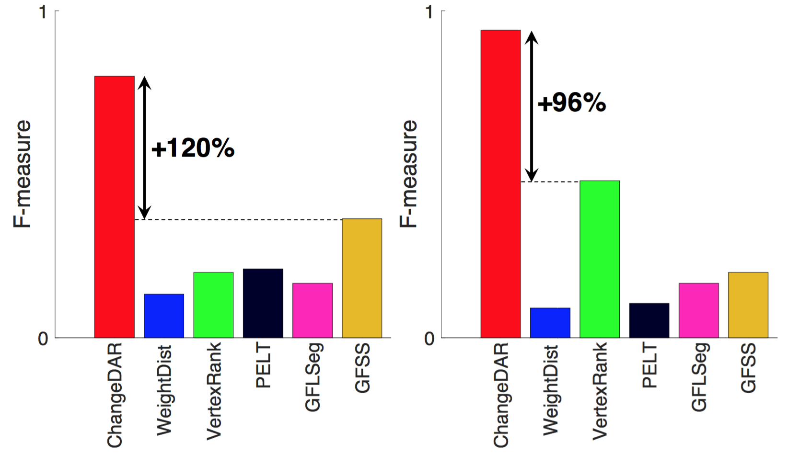
Experiment 1: Power Grid Failures
PolandHVN1
PolandHVN2
Baselines:
Dynamic Graph Change Detection methods (WeightDist, VertexRank)
Model-based Change Detection (PELT)
Fused Lasso (GFLSeg)
Graph Fourier Scan Statistic (GFSS)
Introduction
Problem
Method
Experiments
Conclusion
T3.1: Detecting Anomalous Dynamic Subgraphs
T3.1: Detecting Anomalous Dynamic Subgraphs

Slide 31
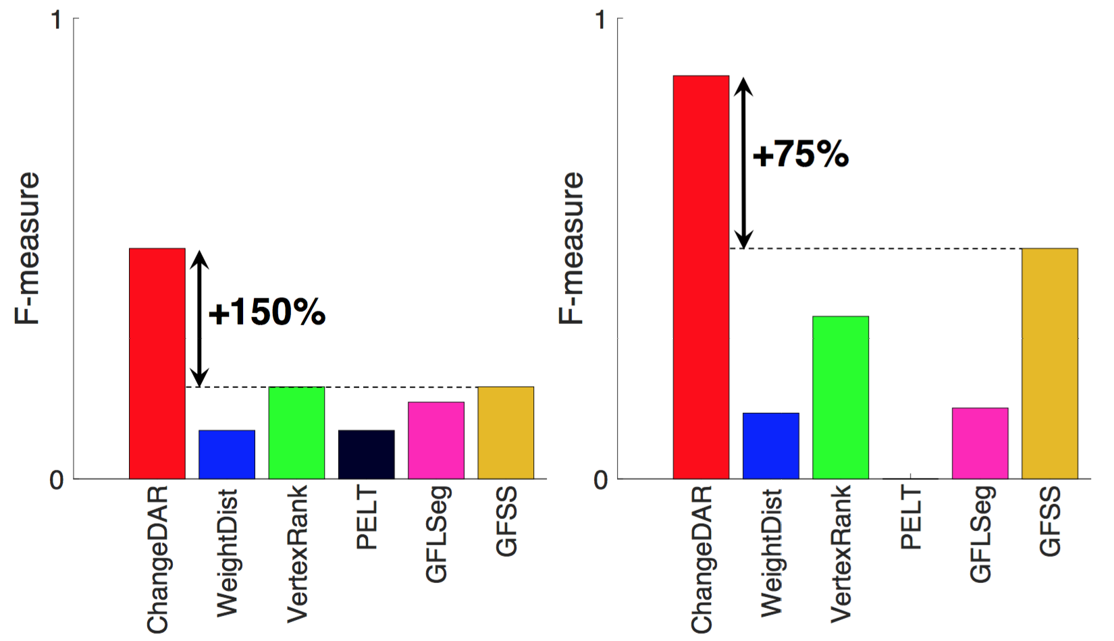
Experiment 1: Power Grid Failures
PolandHVN3
PolandHVN4
Baselines:
Dynamic Graph Change Detection methods (WeightDist, VertexRank)
Model-based Change Detection (PELT)
Fused Lasso (GFLSeg)
Graph Fourier Scan Statistic (GFSS)
Introduction
Problem
Method
Experiments
Conclusion
T3.1: Detecting Anomalous Dynamic Subgraphs
T3.1: Detecting Anomalous Dynamic Subgraphs

Slide 32
Experiment 2: Traffic Accidents
Introduction
Problem
Method
Experiments
Conclusion
T3.1: Detecting Anomalous Dynamic Subgraphs
T3.1: Detecting Anomalous Dynamic Subgraphs

Slide 33
Experiment 2: Traffic Accidents
+70%
+227%
Introduction
Problem
Method
Experiments
Conclusion
T3.1: Detecting Anomalous Dynamic Subgraphs
T3.1: Detecting Anomalous Dynamic Subgraphs

Slide 34
Conclusion
Algorithm: scoring and detection algorithms for a localized change on a graph
Theory: constant factor approximation guarantees
Scalability: near-linear and online
- Code: http://www.andrew.cmu.edu/user/bhooi/changedar/
Introduction
Problem
Method
Experiments
Conclusion
T3.1: Detecting Anomalous Dynamic Subgraphs
T3.1: Detecting Anomalous Dynamic Subgraphs

